Slide 1
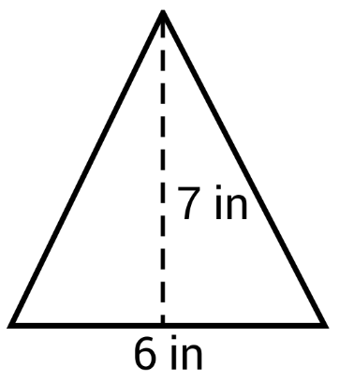
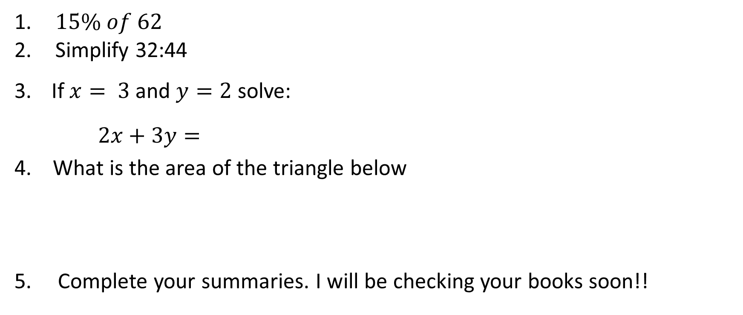
5 Questions
Topic: Time
EQ: How do I convert between 12- and 24-hour time?
$15\% of 62$
Simplify 32:44
If $x= 3$and $y=2$ solve:
$2x+3y=$
4. What is the area of the triangle below
5. Complete your summaries. I will be checking your books soon!!

Slide 2
5 Questions
Topic: Time
EQ: How do I calculate elapsed time?
Increase $42 by 35%
What is 12:30pm in 24-hour time?
Find the median of the following data: 4, 6, 8, 2, 1, 9
What is 1845 in 12-hour time?
Complete your summaries. I will be checking your books soon!!

Slide 3


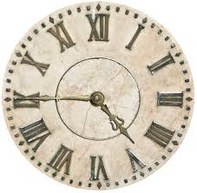


A Review of Time
Analogue Clocks

Slide 4
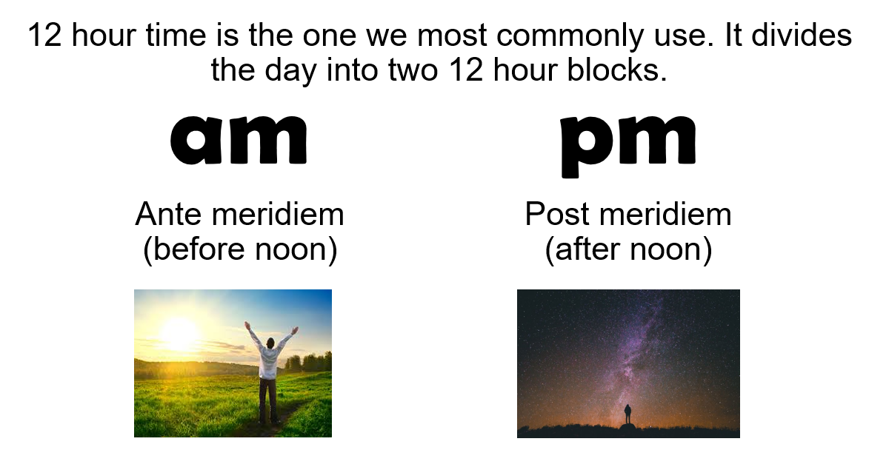
24
7
30
Topic: Time
Date
EQ – How do I convert between 12 and 24 hour time?
What is 12-hour time?
5

Slide 5
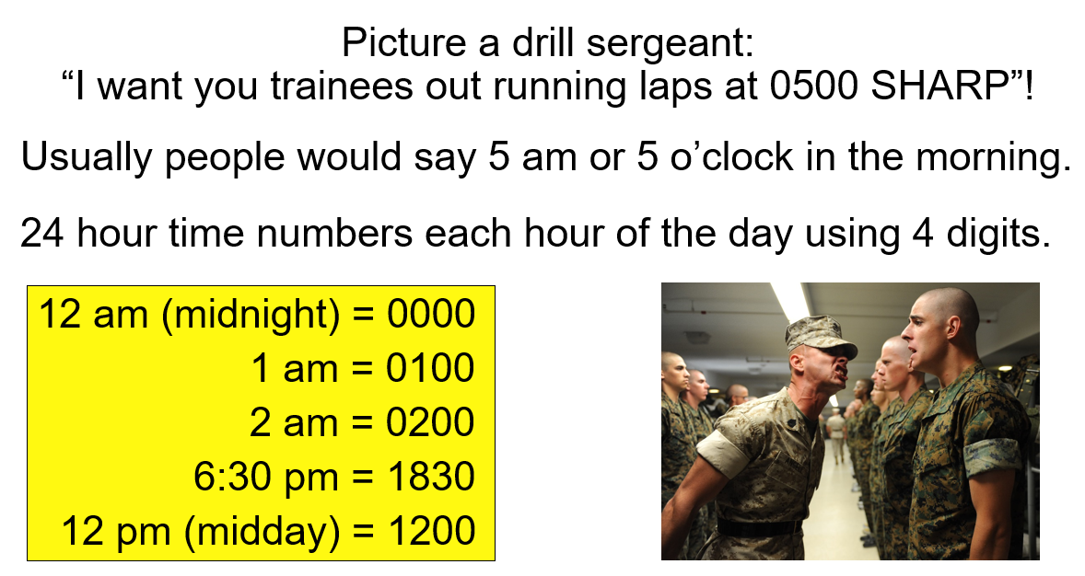
24
7
30
Topic: Time
Date
EQ – How do I convert between 12 and 24 hour time?
What is 24-hour time?
5

Slide 6
12-Hour and 24-Hour Time
24 hr | 12 hr
0100
1000
 | 11 am
1430
 | 11:30 pm
 | 5:45 pm
0915
 | 2:12 am
2151

Slide 7
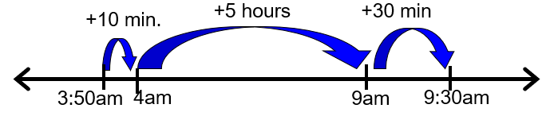
24
7
30
Topic: Time
Date
EQ – How do I convert between 12 and 24 hour time?
How do I solve elapsed time?
Eg For 3:50am and 9:30am, elapsed time is ____ hrs, ____ mins
Step 1) Calculate number of minutes until the next full hour.
Eg There are 10 mins until 4am
Step 2) Calculate number of hours until you reach the correct hour.
Eg There are 5 hours from 4am until 9am
Step 3) Add the minutes needed to get the final time.
Eg 30 min required to get you from 9am to 9:30am
Step 4) Put them together
1o mins + 5 hours + 30 mins
There are 5hrs and 40 mins from 3:50am until 9:30am
One method possible method to work this out is;

Slide 8

Time Elapsed
How long is it between 11:52 am and 12:00 pm?
8 minutes.
This is NOT a decimal point!
How long is it between 6:40 pm and 7:10 pm?
60 min = 1 hr
30 minutes.
How long is it between 9:00 am and 9:00 pm?
12 hours.
How long is it between 2:10 am and 1:30 pm?
11 hours and 20 minutes.

Slide 9

Time Elapsed
Mr Carr attends volleyball training for 1 ½ hours. If he starts at 3:17 pm when will he finish?
4:47 pm.
How many hours does Miss Levitt work if she arrives at school at 6:15 am and leaves at 5:45 pm?
11 ½ hours (11 hours and 30 minutes).
Miss Palmer couldn’t sleep, so she got up early at 3:52 am. She stayed up late too, crawling to bed at 12:01 am.
How many hours was Miss Palmer up for?
21 hours and 9 minutes.

Slide 10
What Happened to 10?
In small groups on your laptops, research the following:
Time is a little bit different…
Why is there 60 seconds in a minute and 60 minutes in an hour?
Why are there 24 hours in a day?
Why are there 7 days in a week?
Why are there 12 months in a year?
Why are there 365 days in a year?
What is a leap year and how often does it occur?
60 seconds = 1 minute
60 minutes = 1 hour
24 hours = 1 day
7 days = 1 week
12 months = 1 year
365 days = 1 year*
*(except leap years)

Slide 11
What have we learnt today?
Lesson Objectives:
I will interpret 24 hour and 12 hour time.
Complete the following table.
24 hr | 12 hr
0400
 | 8:30 pm
1300

